Slide 1


Slide 2
Why sbs?
Double your residual income.
Has a high retention rate.
Easily Adapts to every health client.
A small monthly charge that is affordable for everyone.
No renewals, Rate increases, or support questions.
Benefits to be proud of and no fluff.

Slide 3
Sbs benefits
Discount Vision Program.
Teledoc Service.
Identity Theft Protection.
Roadside Protection Plan.
Legal Service Program.
Access to Licensed Insurance Agents.

Slide 4
Two best & most profitable bundle programs
Health
SBS
WN
Health
SBS
WN
MOO
First bundle should be the minimum package enrolled.
Second bundle package is the ideal package enrolled.
If a client doesn’t medically qualify or is no out the age band for life or active care, the SBS package does not discriminate so there isn’t a reason why SBS wouldn’t be on all your health clients.

Slide 5
Sbs commission schedule
Everyone starts on Tier 1.
Number of policies change your monthly commission.
These are level commissions!
There is a time limit to get to tier 2 which 4/1/2016.
 | Tier 1 | Tier 2
Start point | $8.00 | $8.00
25 subscribers | $8.00 | $10.00
Bonus | 2X | 2X ongoing

Slide 6
Top three Residual programs

Slide 7
How to enroll sbs
There are three ways to enroll a customer.
One: on paper.
Two: electronically on the broker portal.
Three: Automatically through your CRM.

Slide 8
ON Paper
In the back of the benefits guide there is an enrollment form and a bank draft form.
If you do it on paper, it is your responsibility to enter the information for payment into the processing center website.
Please make sure to properly destroy your customers bank information when you are done with it.

Slide 9
Online through broker portal
Log into the broker portal on niabrokers.com and you will see SBS listed on the first page.
Fill out all required fields including the bank information and then hit submit. You are done!
The customer gets a confirmation as well as you the broker so you know the transaction is complete.

Slide 10
Online through your crm
Log into the CRM and click on your customer.
Click on the drop down box and choose SBS.
All the required field will automatically be populated by the CRM including the banking information if they are an HSA customer.
Click the enroll now button and you are done!
The same confirmation you will to the customer and you.

Slide 11
Sbs support
We have a support team who will be open to answer any calls from your customers.
Every Customer gets a welcome package in the mail with their ID cards for vision along with cards for Roadside and Teledoc.
They will receive an additional card with every benefit listed on it with the phone number for each benefit.
There is also an website for them to explore their benefits.

Slide 12
Sbs support for Brokers
Each Broker will have their own access to their list of clients in real time.
Every broker will be able to look at the their own PID report to see which clients are current.
You will be able to access the SBS system on your laptop, IPad, or mobile device.

Slide 13
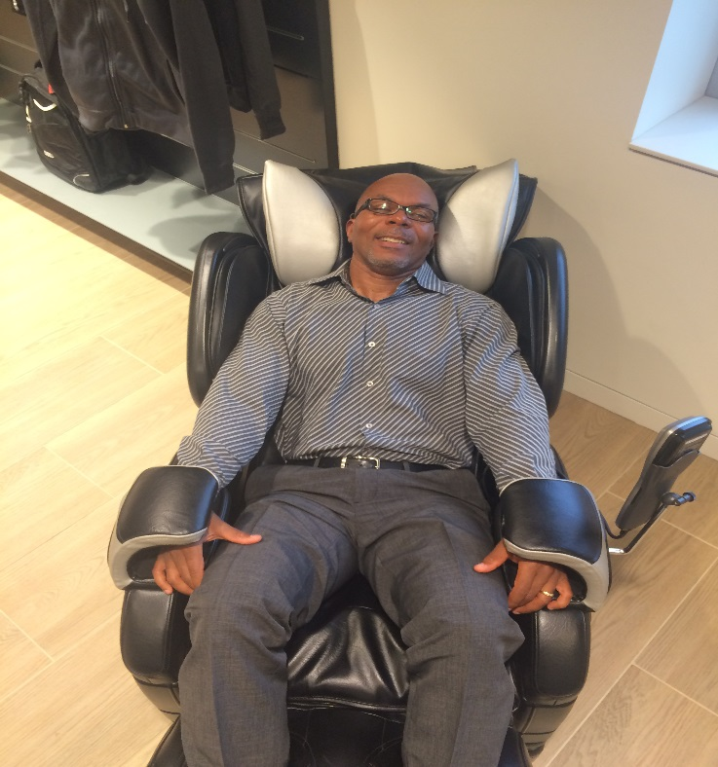

What Kind of broker will you be?
One who just lays around and squanders opportunities?
Or a cowboy hunting down SBS subscriptions?

